Slide 1

DMS Inventory Management System
Master of Computer Applications
[Batch 2019-2021]
Technology: Python Django
Submitted in the partial fulfillment for the Semester-V Mini-Project
Project Guide: Dr. Hetal Thaker
Group-2

Slide 2
Team Members
191823002 | Aghera Kevin Bipinbhai
+91 81401 69137 | kevinaghera1999@gmail.com
191823011 | Garach Devang Bharatbhai
+91 84603 52525 | devanggarach@gmail.com
191823008 | Changela Savan Prasudbhai
+91 95378 39403 | savanchangela273@gmail.com
Group-2
DMS Inventory Management System | Mini Project | Semester - V

Slide 3
Agenda
Project Overview
Core Components
System Requirements
Tools and Technologies
About Existing System
Targeted Users
Use Case Diagram
Activity Diagram
Class Diagram
Sequence Diagram
Timeline Chart
Screenshots

Slide 4
Project Overview
DMS is online stock management application, invoicing by scan QR Code, statistical data and some other features which will help to grow their business, on web-based application responsive design mobile, tablet, desktop supportive, for any small or large scale business/organization, which covers all sports store, supermart, gift and home-decor shop, book store, stationery, hardware, auto-parts store.
DMS Inventory Management System
Group-2
🏠

Slide 5
Core Components
In this application/system there are seven modules which are described below
Login Module
Registration of any organization, Registration of any organization, while registration we will take basics details about organization which will take be like business name, username, password, address, city, state, contact details and business logo, GSTIN Number. Once registration completes, authenticate user of organization has to login via their username and password.
Stock Management Module
Stock Management Module is divided into 2 sub-modules, Add Products, Add/Modify Stock Details. While adding products or modifying stock details we will get some details like, product name, quantity, HSNCode, Cost Price, Selling Price, expire date, packing date. User can add product manually or they can insert directly stocks, if there is any new product it will automatically first add product and then it add stocks.
Group-2
DMS Inventory Management System | Mini Project | Semester - V
🏠

Slide 6
Core Components (Continue...)
Billing Module
User will scan the products QR Code and each items will be added to list of billing desk, billing was done with some basic calculation related to GST and discount based on product. Qty*SellingPrice=Amount,AmountDiscount=TaxableAmount, TaxableAmount+GST=TotalAmount information we get while billing are Customers Mobile/email, Selling Price(With GST). Quantity, Payment Mode
Print Module
Based on the product inserted into the stock user can also print out the QR code, they can select the product and system will ask how many QR Code must be printed for per product.
Stock Notify Module
If any stock is less than given limit or product is expired then it will notify instantly to owner, to remove that stock from their shop.
Group-2
DMS Inventory Management System | Mini Project | Semester - V
🏠

Slide 7
Core Components (Continue...)
Report & Analysis Module
All kind of statistical data will be displayed here which will help owner to boost their business/ entire organization. Report & Analysis details like..
Maximum Selling Product in the Day
Maximum Selling Product in the Month
Unique Customers
Total Products in their Shop
Which Products not sale in Day or Month
Product wise selling count Report of the Day, Month & Year
Profit of the Day, Month and Year
Current Stock Report
Sales Return Products
And Many More Reports with PDF and Excel files.
Sales Return Module
Whenever any customer return any product, due to any reason like damaged product, Defective Product, Product not as per expected, etc... We will get some details at the time of sales return like, Customer Mobile, Product ID, Quantity, Note (Reason for Return)
Group-2
DMS Inventory Management System | Mini Project | Semester - V
🏠

Slide 8
System Requirements
Minimal Hardware Requirements
Operating System | Microsoft Windows 7, 8 or 10, Ubuntu, Mac
CPU Processor | Dual Core 3rd Gen. or above
RAM | 2GB
Hard Disk | 250GB
Camera | 2.0 MP TrueVision
Group-2
DMS Inventory Management System | Mini Project | Semester - V
🏠

Slide 9
System Requirements (Continue...)
Software Requirements
Python 2.7+ | Support some libraries, (if requires)
Adobe Reader or any pdf reader | Used for Label printing and billing
MS Excel | Checking Excel sheet files
Chrome Browser 30+ or any browser | For Running application
Network Requirements
Mobile Data Plan | 3G or Above
Group-2
DMS Inventory Management System | Mini Project | Semester - V
🏠

Slide 10












Tools and Technologies
Group-2
DMS Inventory Management System | Mini Project | Semester - V
🏠

Slide 11
About Existing System
There are many billing system like zoho, vyaparapp, justbilling, retailcore, Anapurna Supermarket, etc. Some of applications works Online or Offline standalone applications. Many system are just for specific purpose, supports only stock management and billings, While some of system also gives statistical information and analysis of stock with profit/loss, and to track customers buying analysis, and many more.
Group-2
DMS Inventory Management System | Mini Project | Semester - V
🏠

Slide 12
Targeted Users
Targeted users are any small or large scale business/organization, which covers all sports store, supermart, gift and home-decor shop, book store, stationery, hardware, auto-parts store. Targeted to Small Shops First.
Group-2
DMS Inventory Management System | Mini Project | Semester - V
🏠

Slide 13
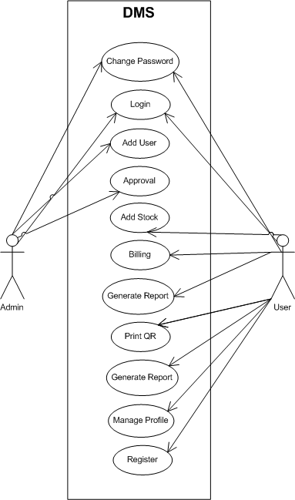
Use Case Diagram
DMS Inventory Management System
Group-2
🏠

Slide 14
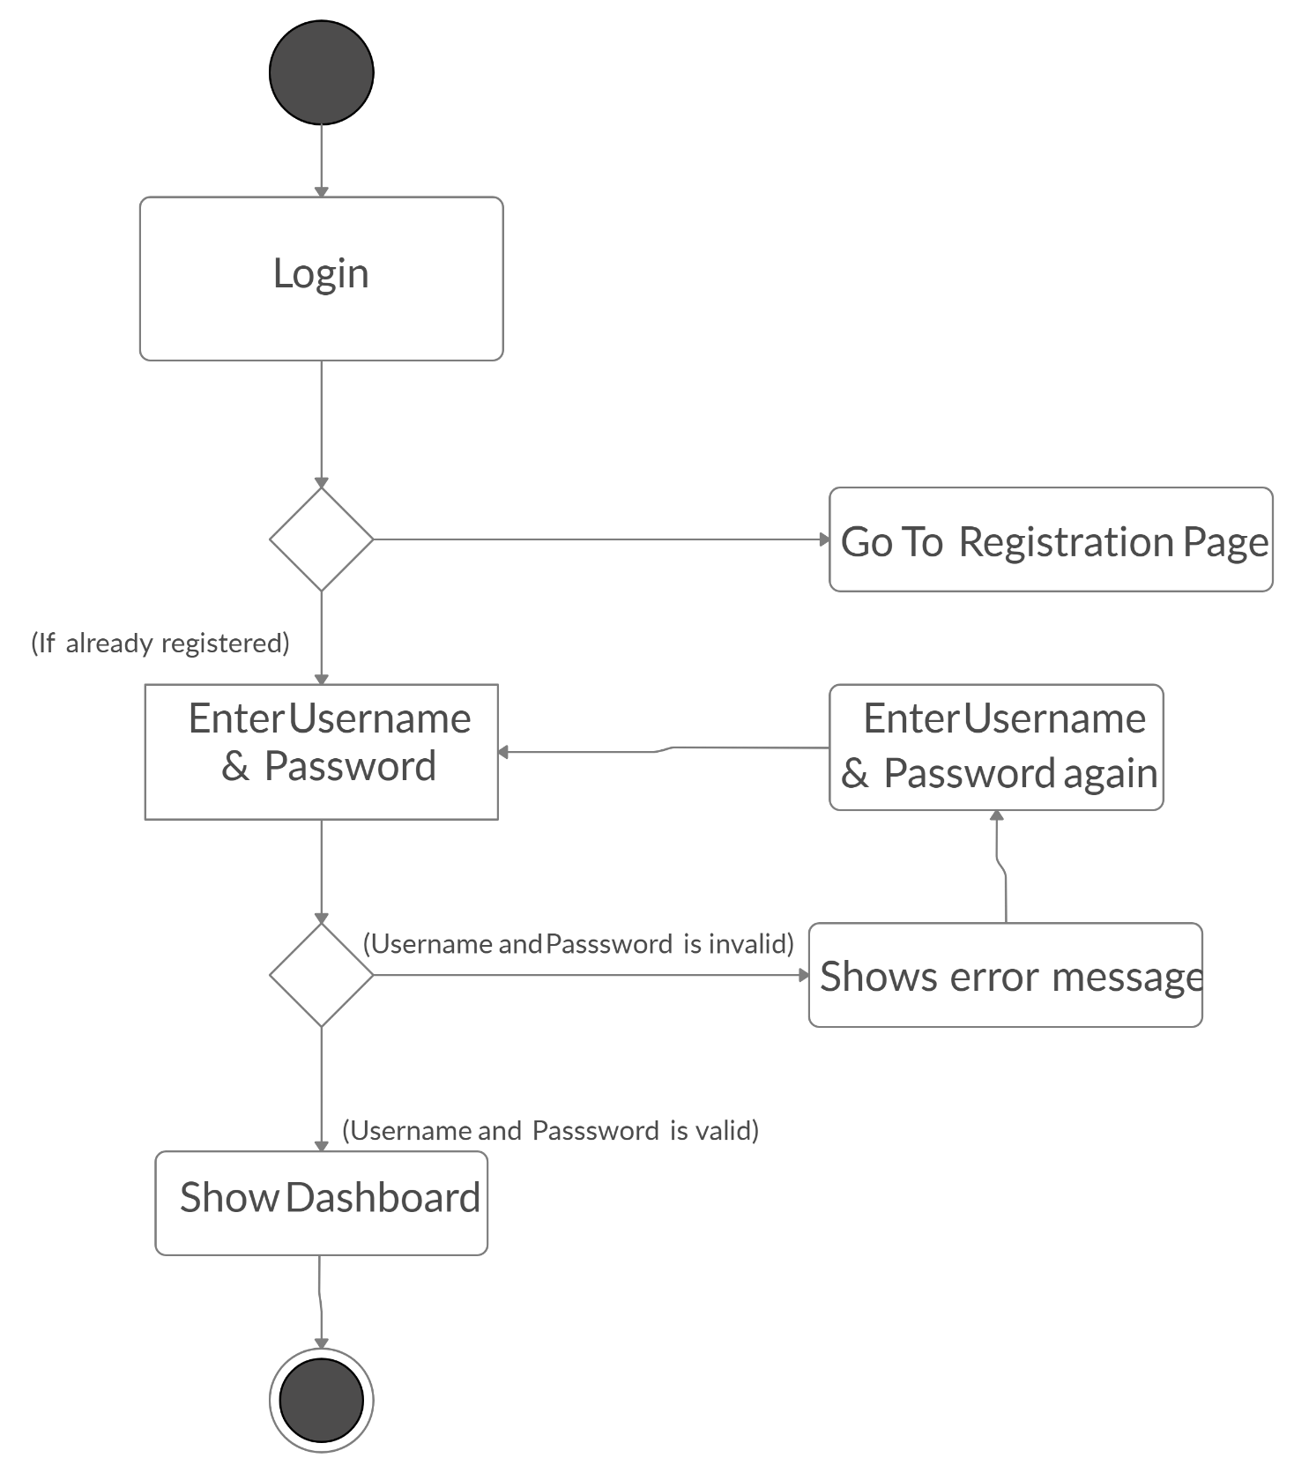
Activity Diagram
DMS-Login
Group-2
🏠

Slide 15
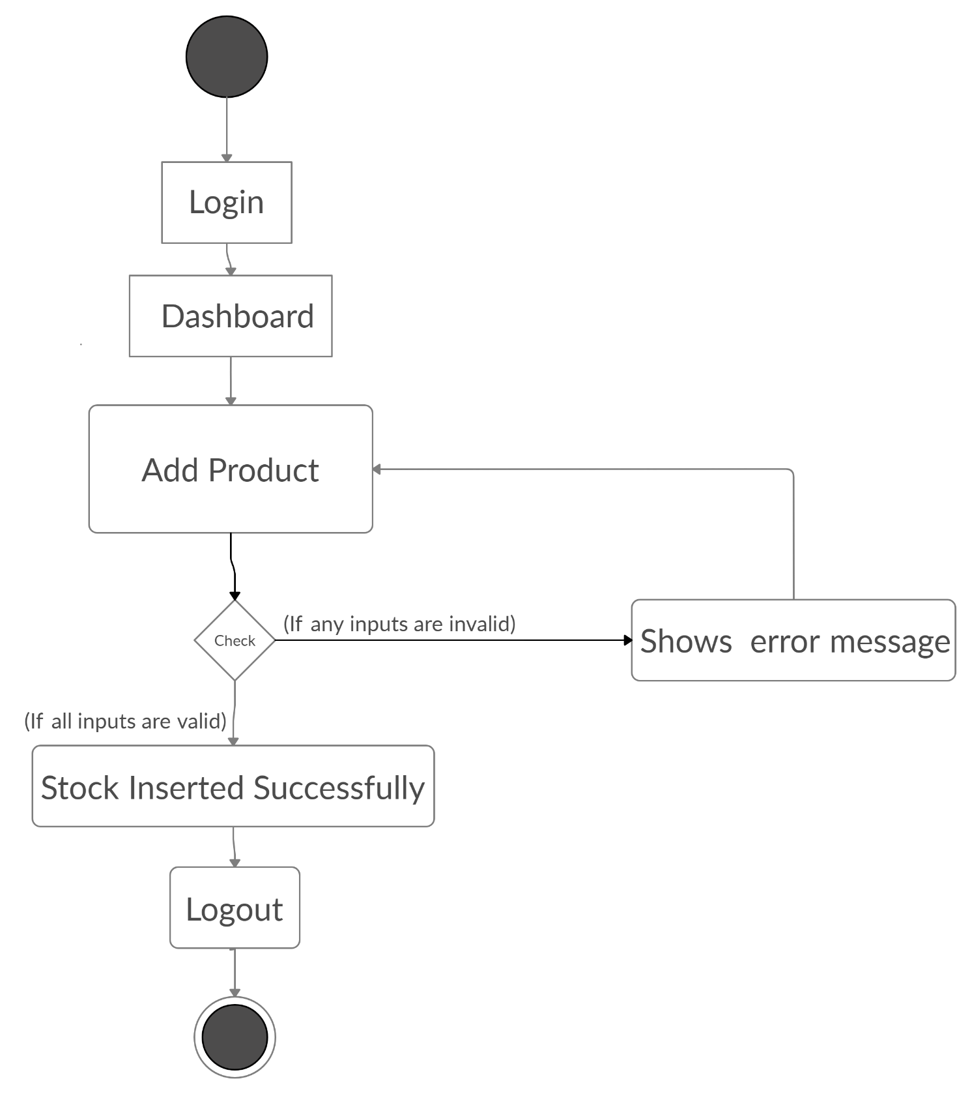
Activity Diagram
DMS-Add Product
Group-2
🏠

Slide 16
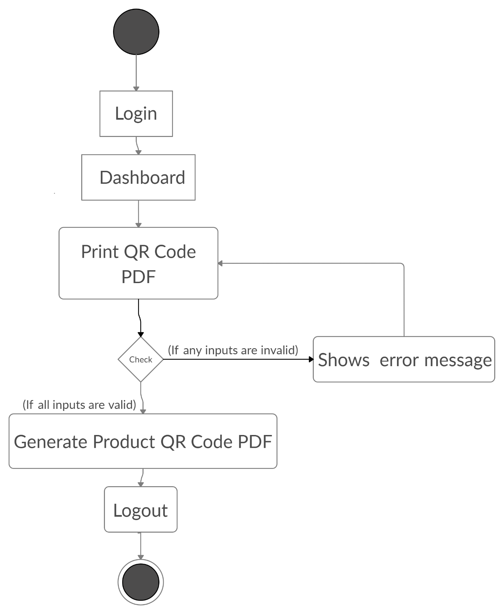
Activity Diagram
DMS-Print QR Code PDF
Group-2
🏠

Slide 17
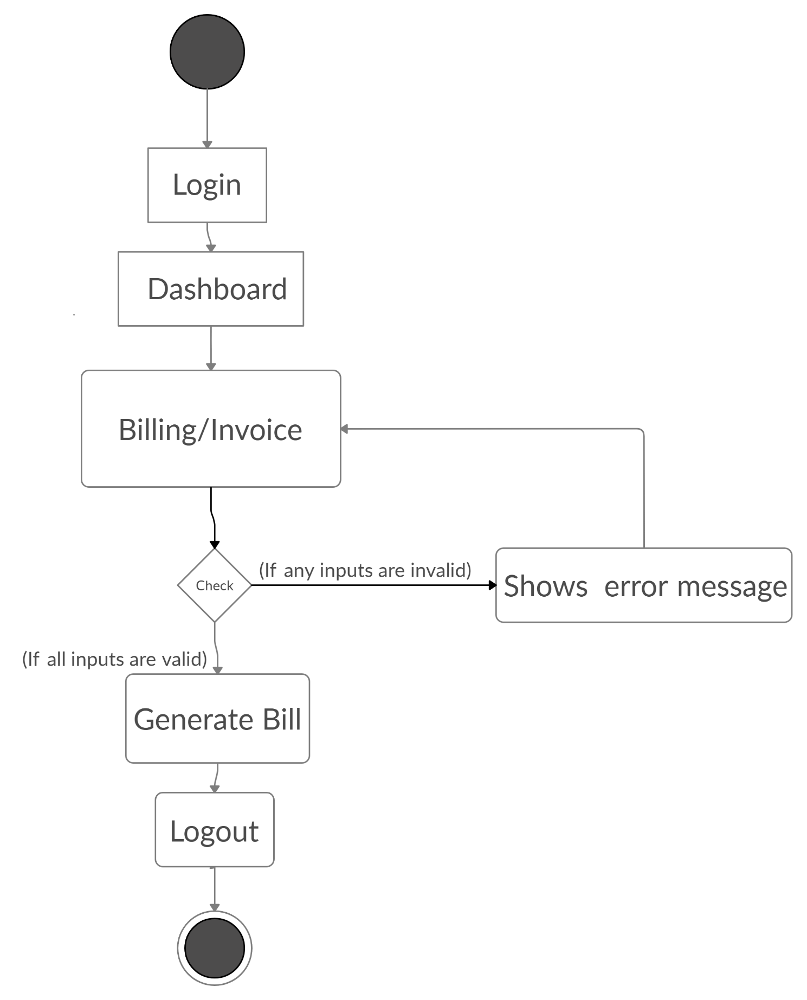
Activity Diagram
DMS-Billing
Group-2
🏠

Slide 18
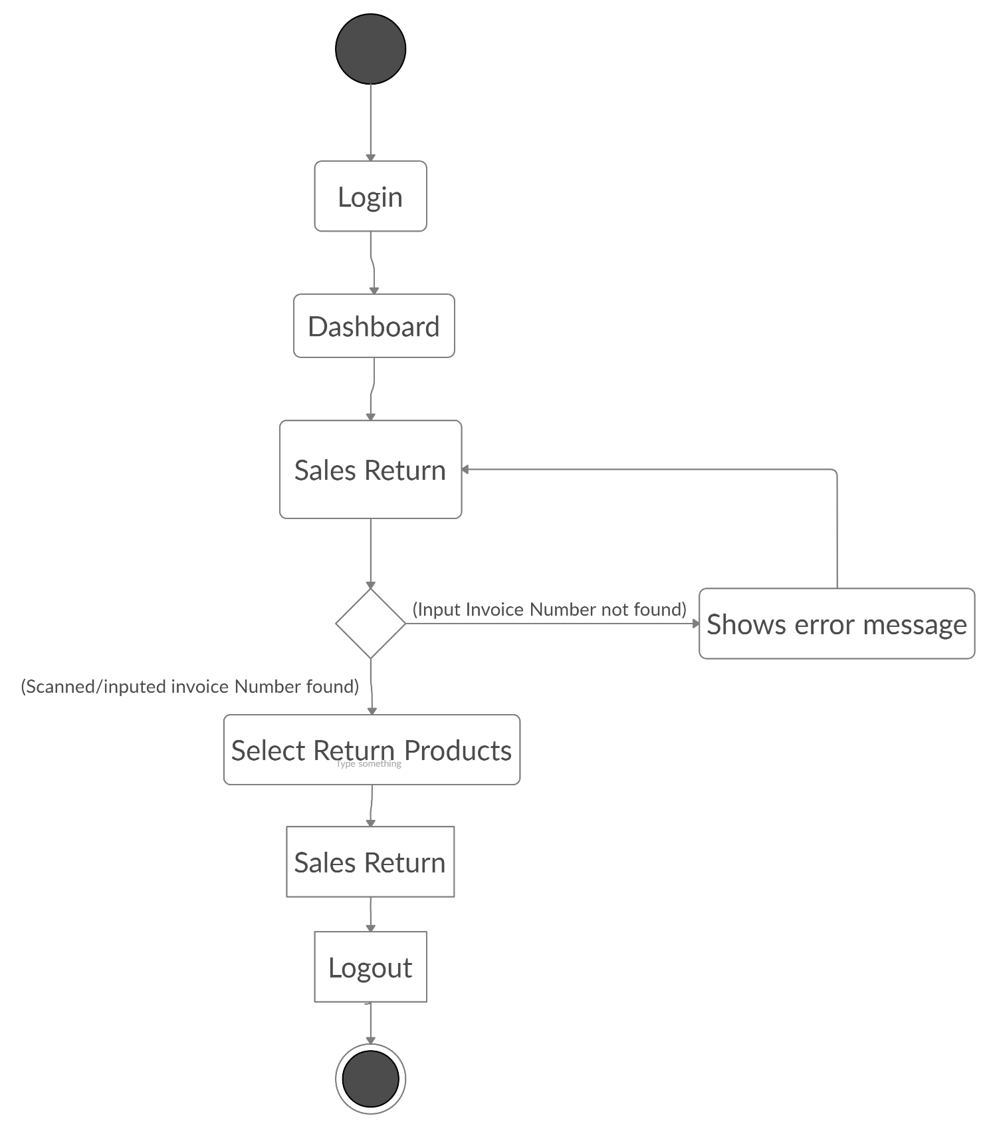
Activity Diagram
DMS-Sales Return
Group-2
🏠

Slide 19
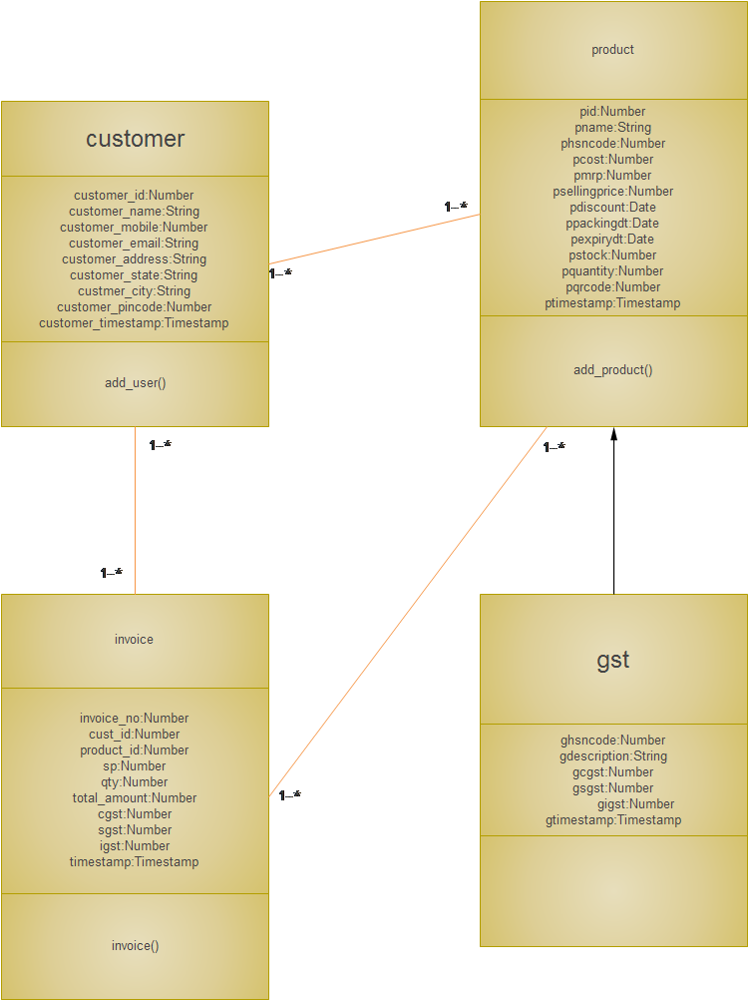
Class Diagram
DMS Inventory Management System
Group-2
🏠

Slide 20
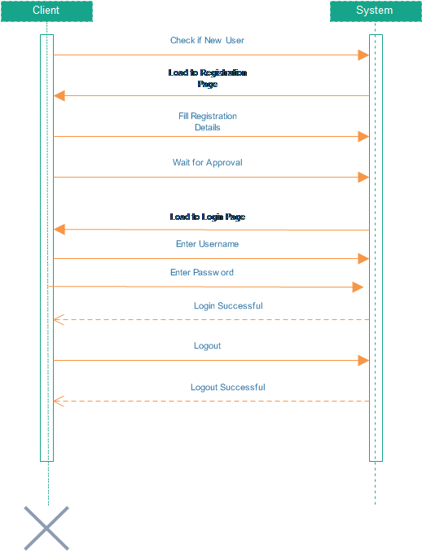
Sequence Diagram
DMS-Login
Group-2
🏠

Slide 21
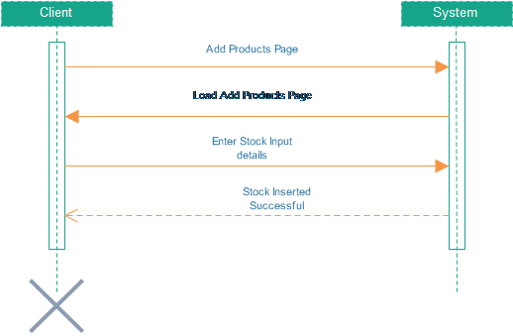
Sequence Diagram
DMS-Add Product
Group-2
🏠

Slide 22
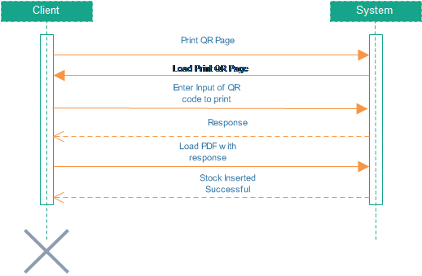
Sequence Diagram
DMS-Print QR Code
Group-2
🏠

Slide 23
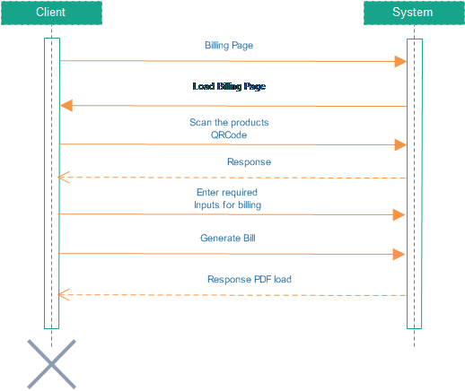
Sequence Diagram
DMS-Billing
Group-2
🏠

Slide 24
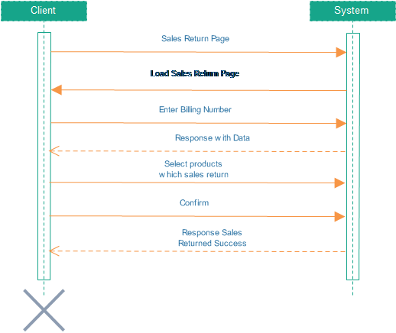
Sequence Diagram
DMS-Sales Return
Group-2
🏠

Slide 25
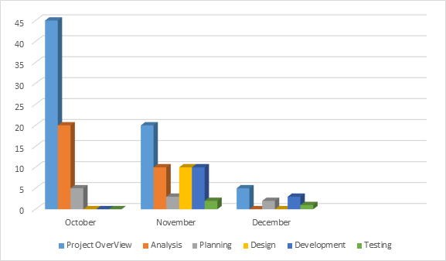
Timeline Chart
DMS Inventory Management System
Group-2
🏠

Slide 26
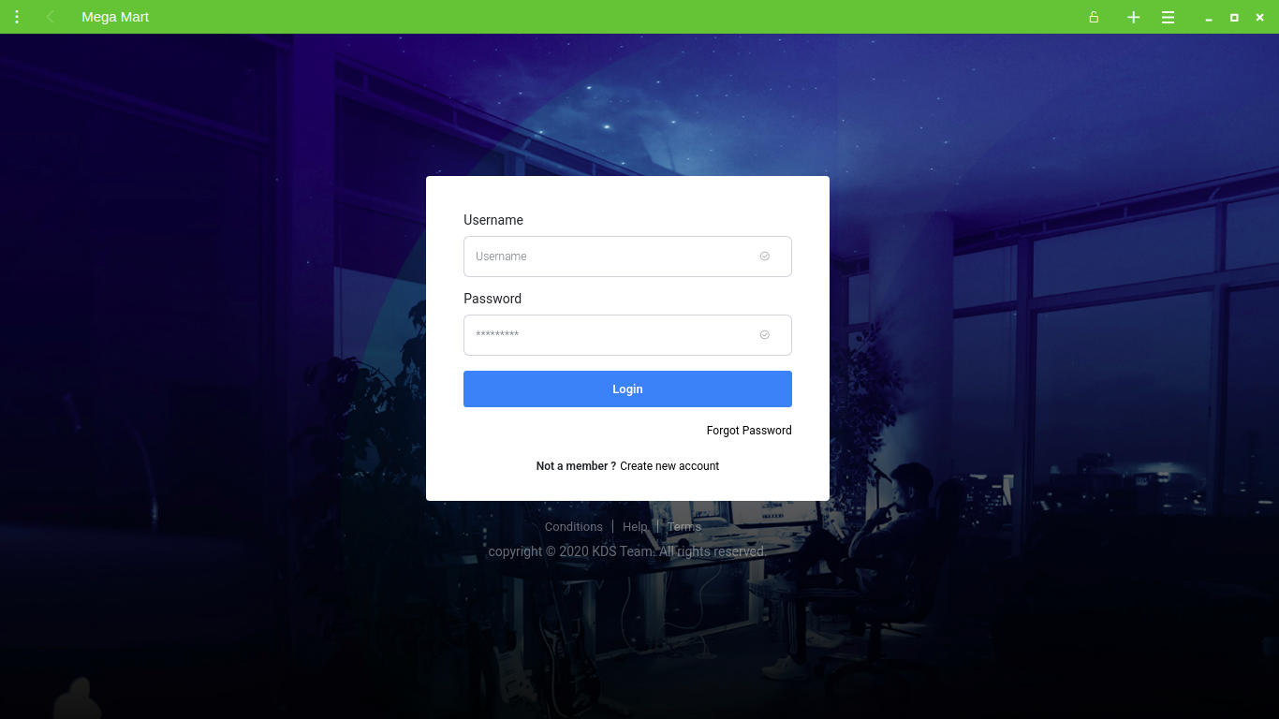
Screenshots
Login
🏠

Slide 27
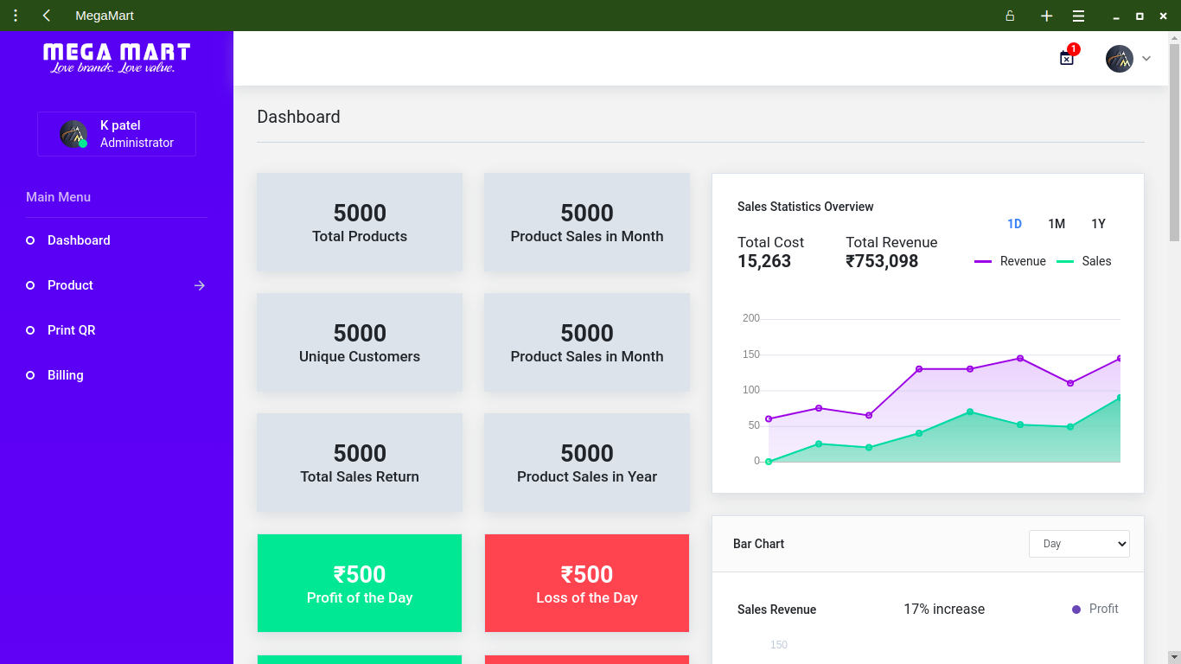
Screenshots (Continue...)
Dashboard
🏠

Slide 28
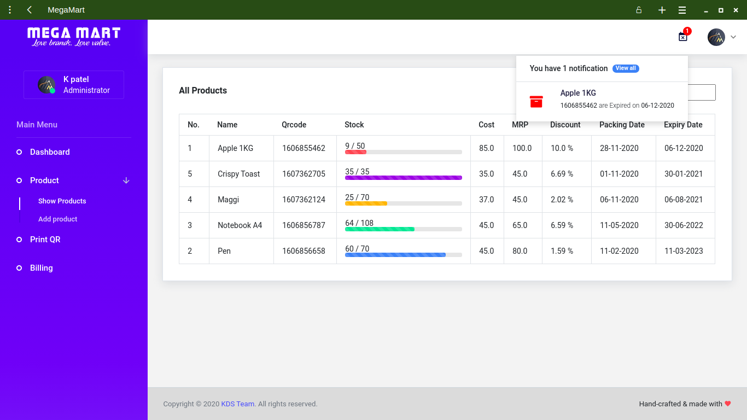
Screenshots (Continue...)
All Products
and
Notification of Expired Products
🏠

Slide 29
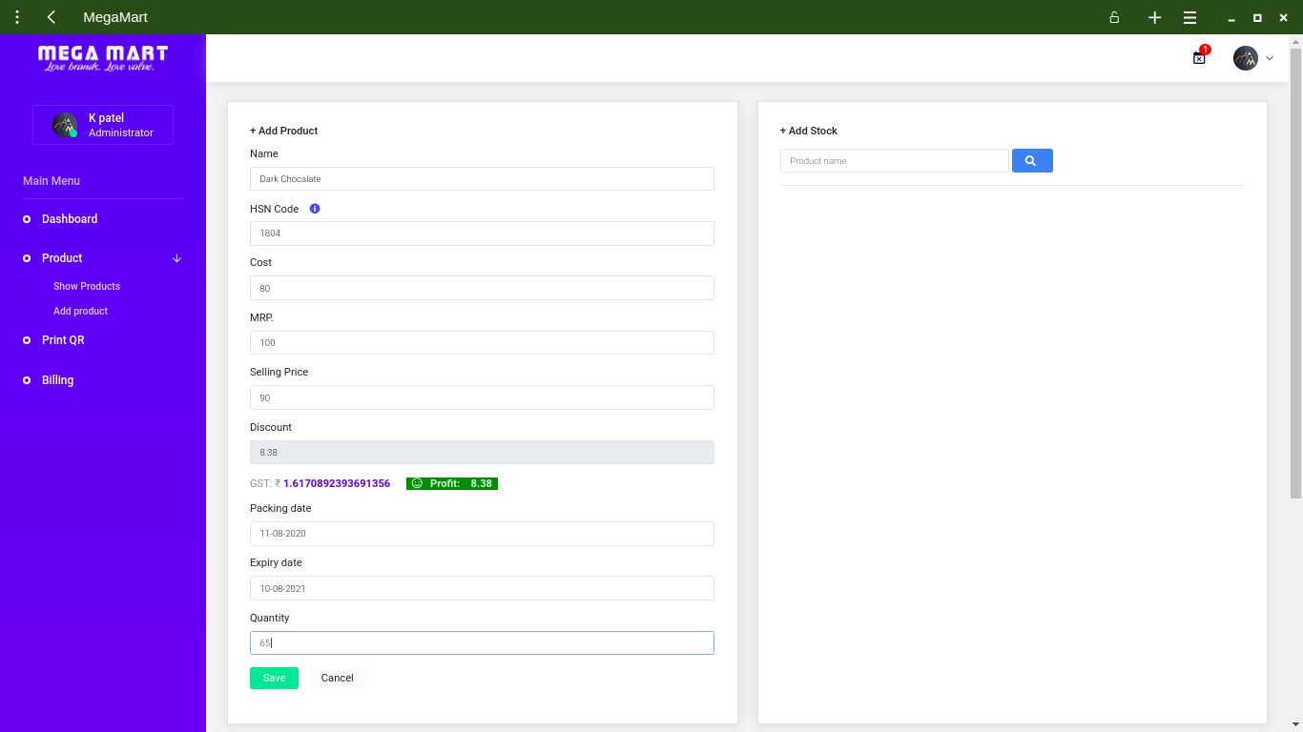
Screenshots (Continue...)
Add Products
🏠

Slide 30
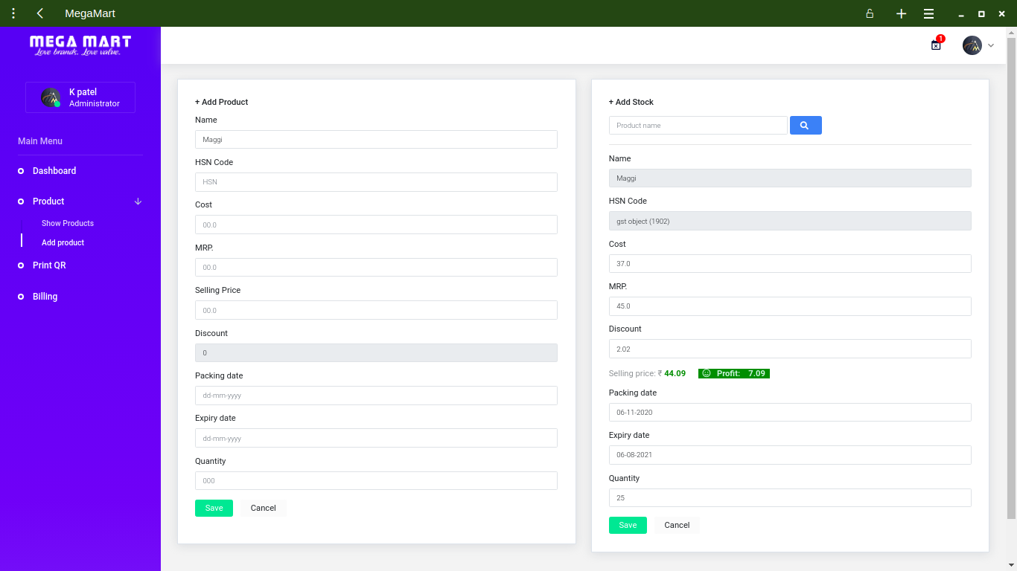
Screenshots (Continue...)
Adding Products with same which is already inserted
🏠

Slide 31
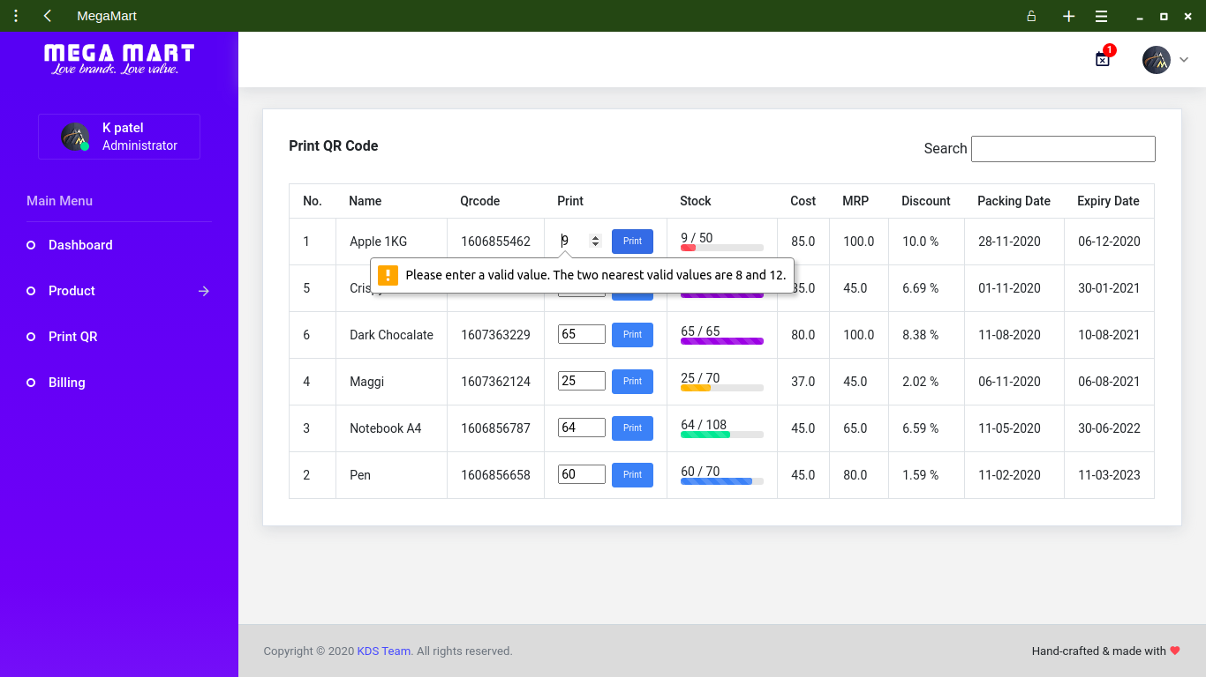
Screenshots (Continue...)
Print QR Code
🏠

Slide 32
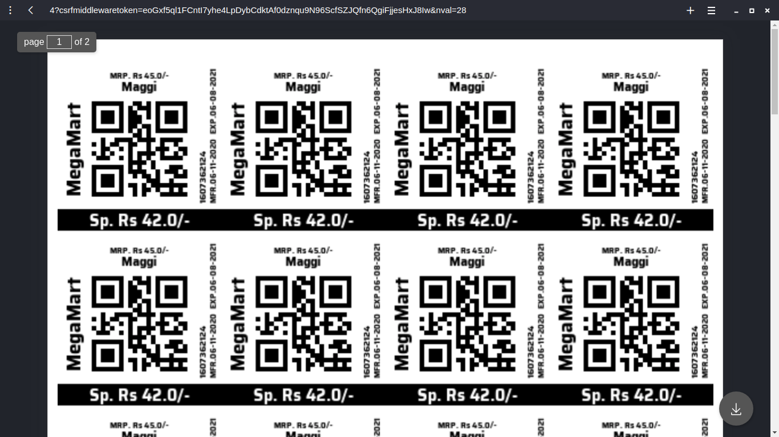
Screenshots (Continue...)
Downloading PDF of QR Code
🏠

Slide 33
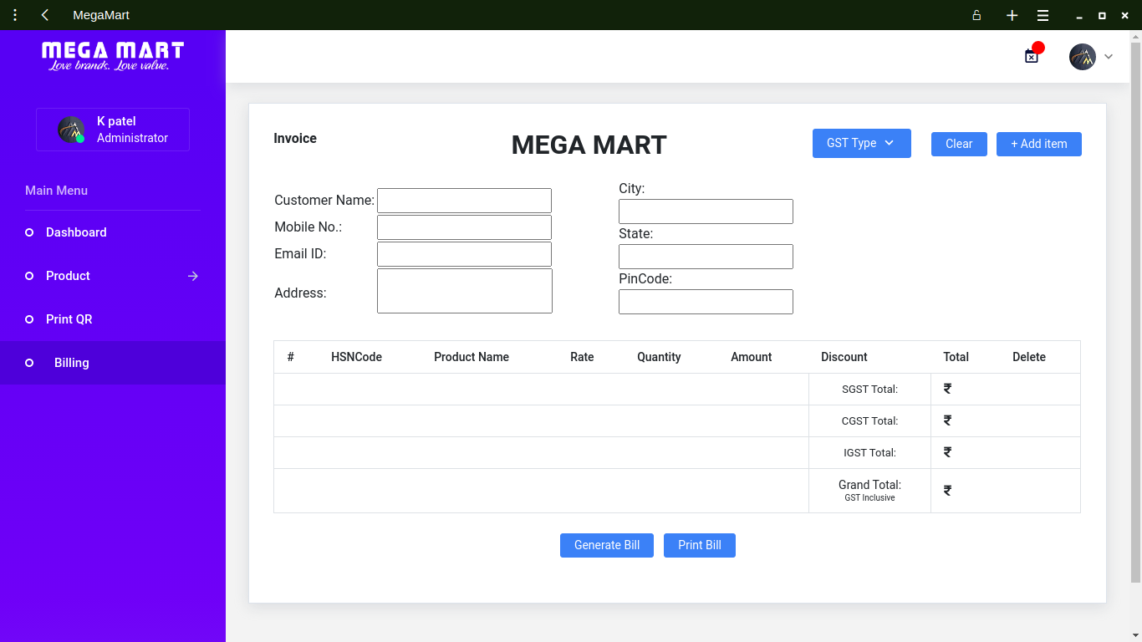
Screenshots (Continue...)
Billing
🏠

Slide 34
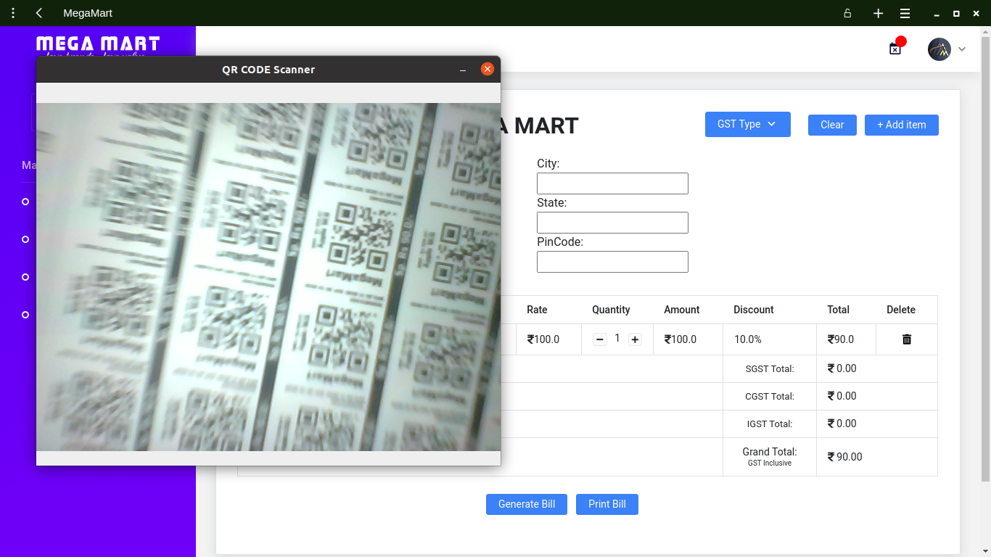
Screenshots (Continue...)
Adding Item with QR Code Scanner
🏠

Slide 35
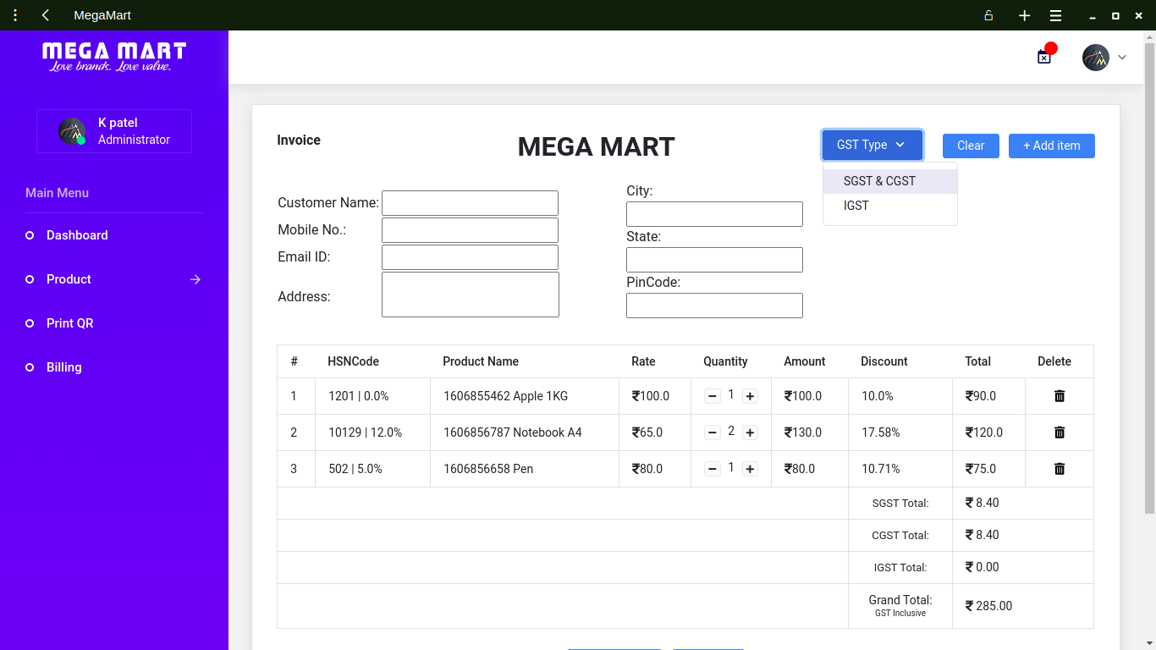
Screenshots (Continue...)
Default GST type is SGST & CGST
🏠

Slide 36

Screenshots (Continue...)
Changing to GST type IGST
🏠

Slide 37
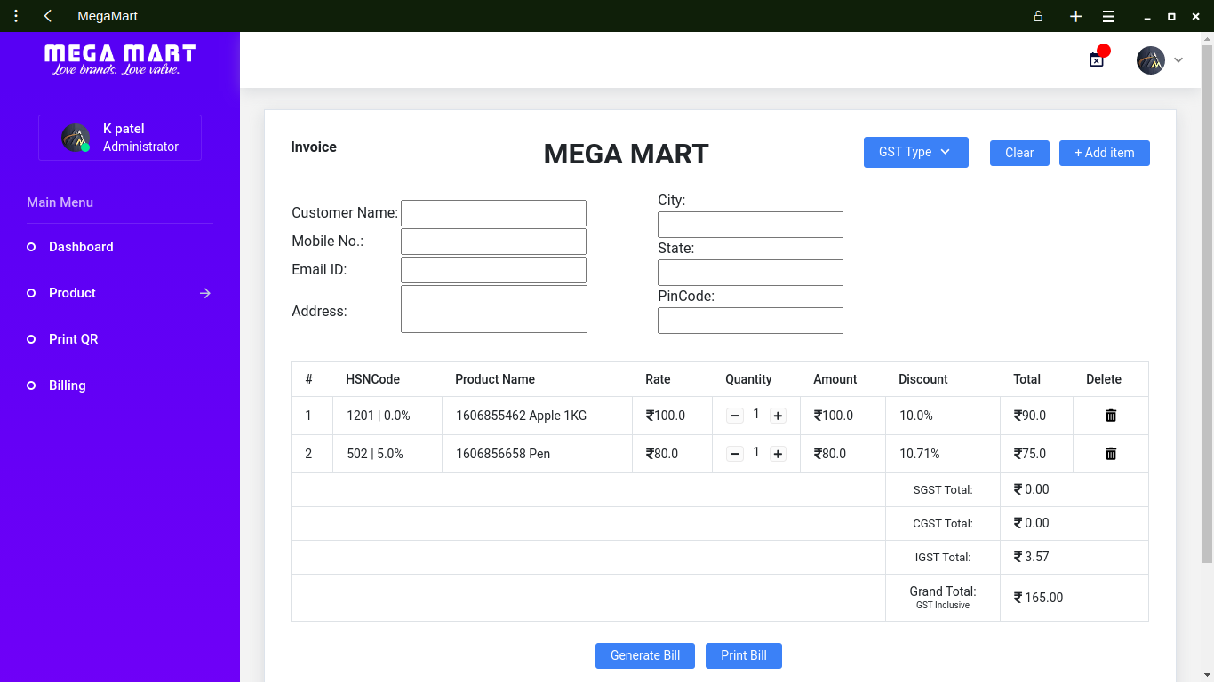
Screenshots (Continue...)
Deleting Item from billing products
🏠

Slide 38
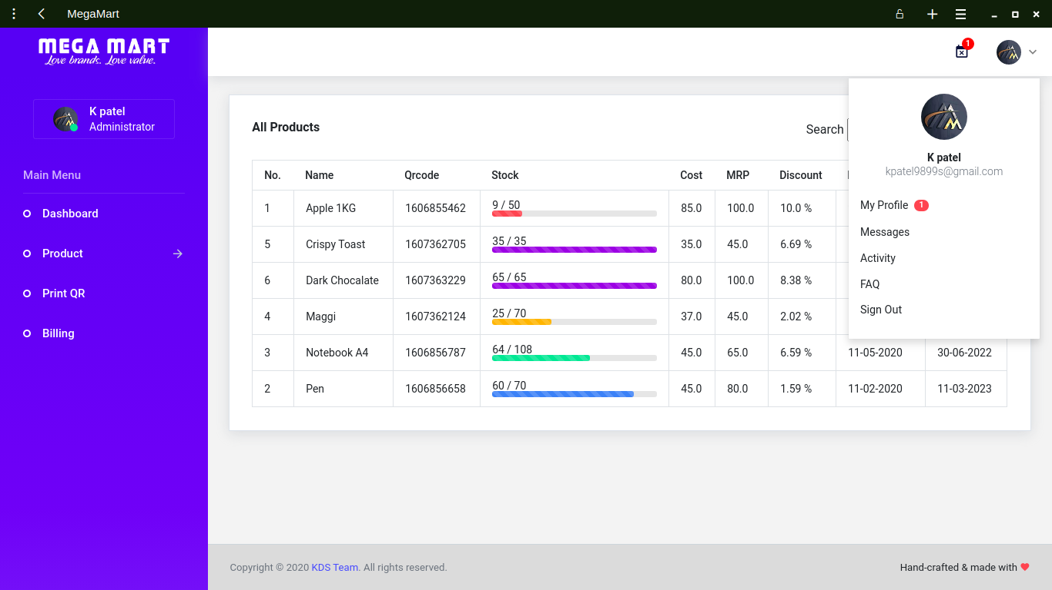
Screenshots (Continue...)
Logout
🏠

Slide 39
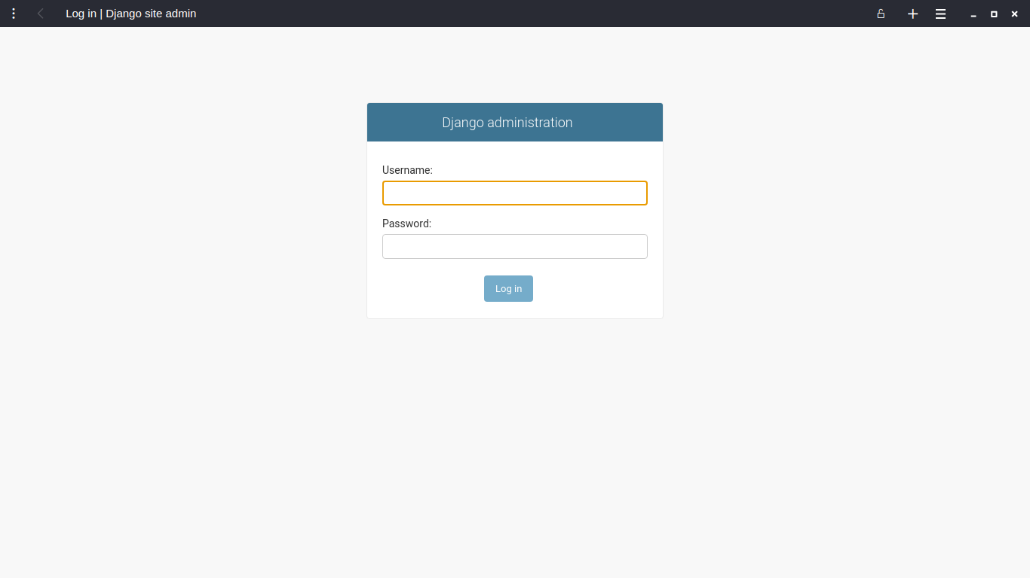
Screenshots (Continue...)
Admin Login
🏠

Slide 40
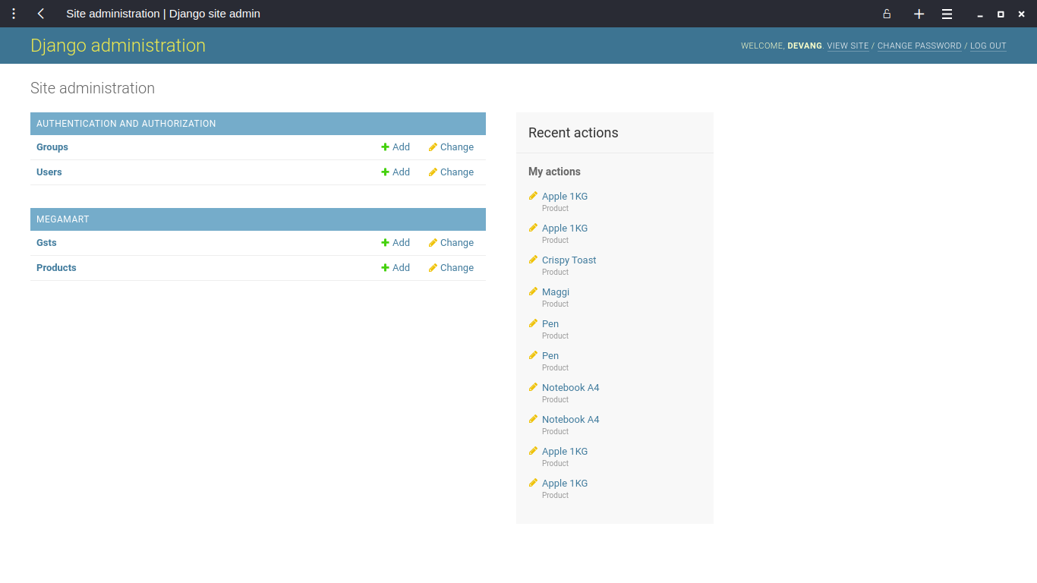
Screenshots (Continue...)
Admin Dashboard
🏠

Slide 41
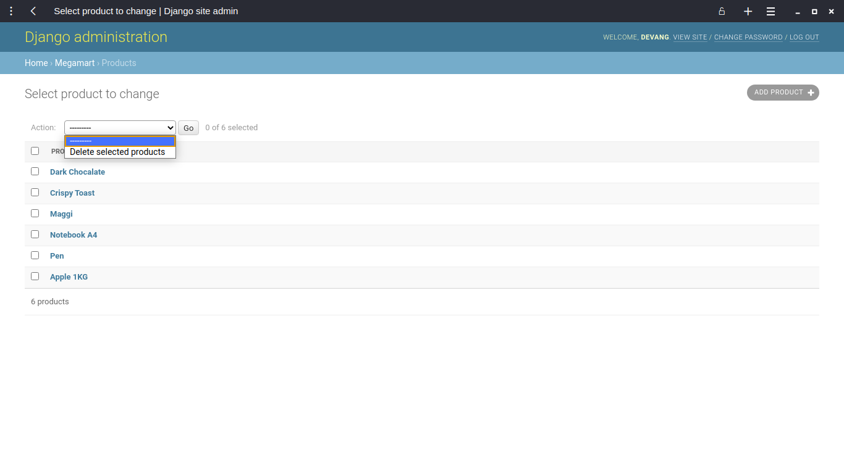
Screenshots (Continue...)
Admin Checking and Deleting products from product table
🏠

Slide 42
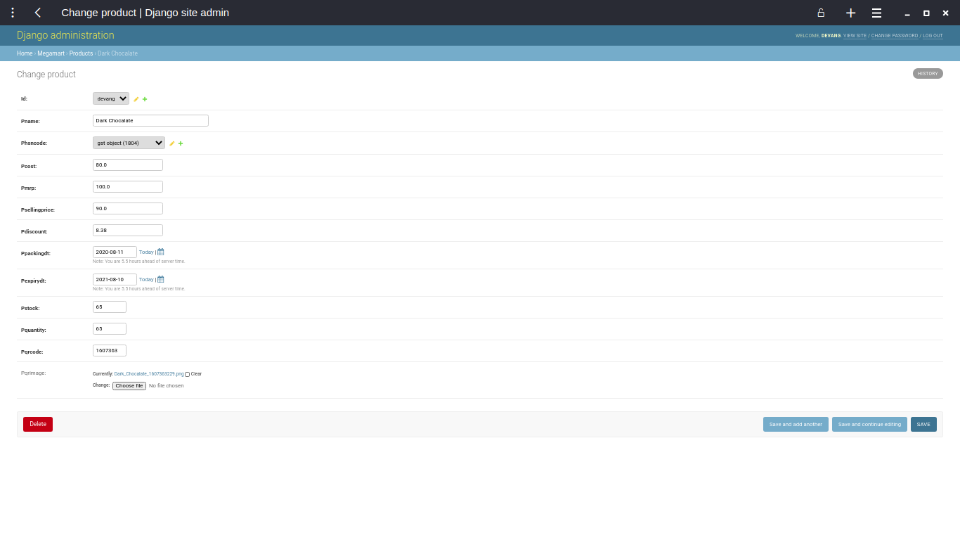
Screenshots (Continue...)
Admin Modifing Inserted Record in product table
🏠

Slide 43
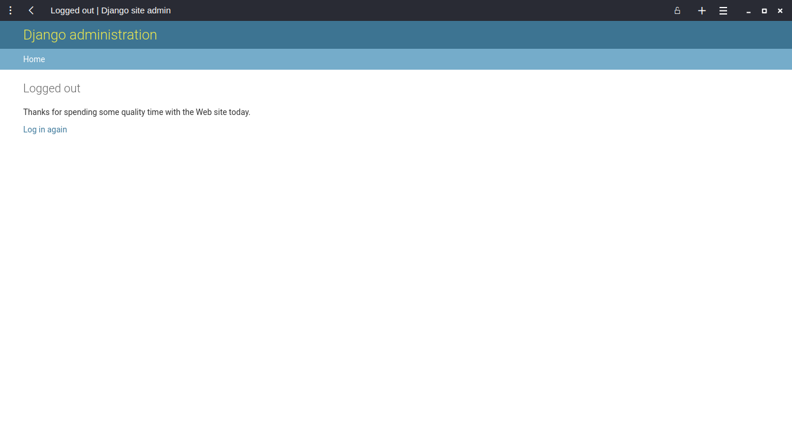
Screenshots (Continue...)
Admin Logout
🏠

Slide 44
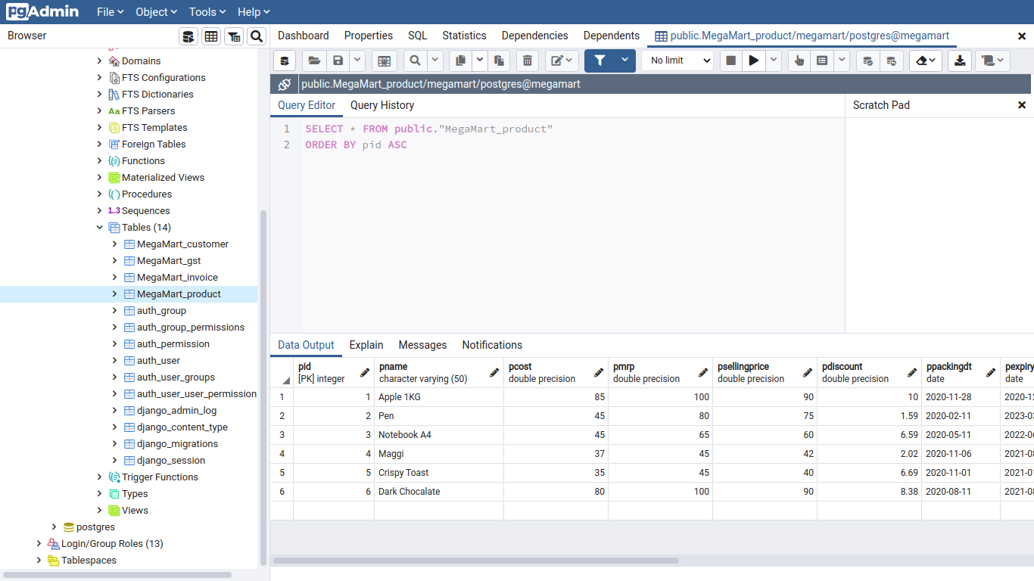
Screenshots (Continue...)
Admin Postres Database view 1
🏠

Slide 45
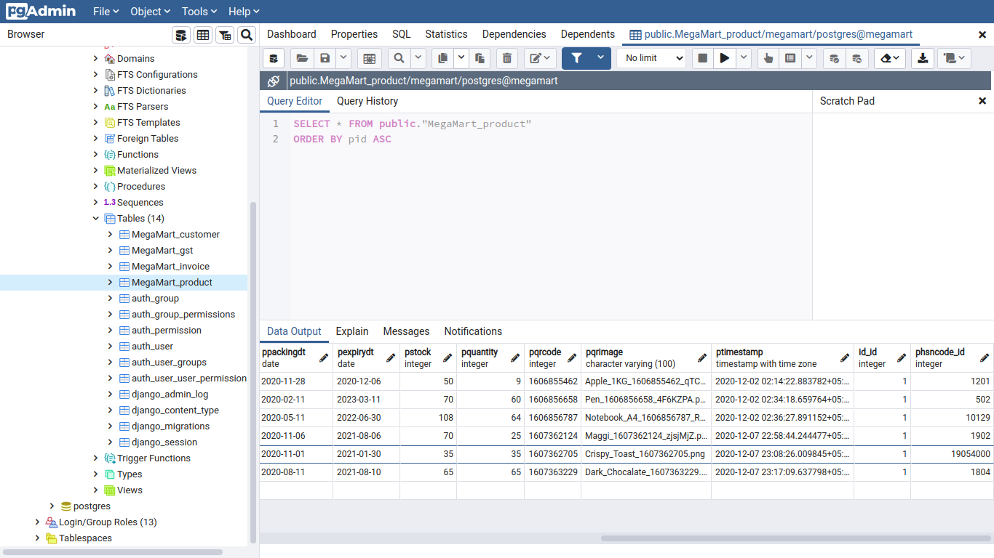
Screenshots (Continue...)
Admin Postres Database view 2
🏠

Slide 46
Thank you
Group-2 Team Members
growth
191823002 | Aghera Kevin Bipinbhai
+91 81401 69137 | kevinaghera1999@gmail.com
191823011 | Garach Devang Bharatbhai
+91 84603 52525 | devanggarach@gmail.com
191823008 | Changela Savan Prasudbhai
+91 95378 39403 | savanchangela273@gmail.com
Master of Computer Applications
[Batch 2019-2021]

